Slide 1
Introduction to Big Data

Slide 2

















What is “Big Data”?
Reference: http://en.wikipedia.org/wiki/Big_data)

Slide 3





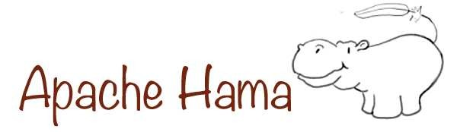
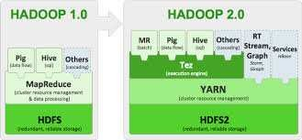






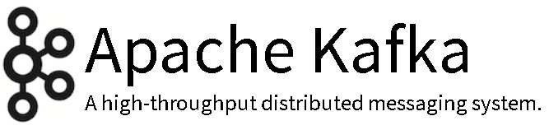


The importance of Big Data in the Data Science equation
Large data sets are not new (e.g. Energy, Telecomm, etc.)
When the data itself becomes part of the problem (e.g. pushing existing limits)
“Big Data” embodies a set of tools and technologies for dealing with vast data sets (e.g. capturing, storing, accessing, processing, etc.)
Increased data volume dictates increased sophistication in the analysis and use of that data – the foundation of data science.
© 2013-2

Slide 4
Part I:
Characterizing Big Data

Slide 5
Data Size
1,024 Zettabytes (2⁸⁰)
≈10²⁴
1,024 Petabyte
≈10¹⁸
1,024 Gigabyte
≈10¹²
1,024 Kilobytes
≈10⁶
 | Yottabyte | 1,0
s (2⁶⁰)
 | Zettabyte
 |  | 1,0
 | Exabyte
s (2⁴⁰)
 | Petabyte
 |  | 1,0
 | Terabyte
(2²⁰)
 | Gigabyte
 |  | 1,0
 | Megabyte
 | Kilobyte
Yottabyte
Zettabyte
24 Exabytes (2⁷⁰)
≈10²¹
24 Terabytes (2⁵⁰)
≈10¹⁵
24 Megabytes (2³⁰)
≈10⁹
24 or (2¹⁰ bytes)
≈10³
Exabyte
Petabyte
Terabyte
Gigabyte
Megabyte
Kilobyte

Slide 6
Data Format/Composition/Mode of Access
File System
Collection of files; local
File System
vs. network/distributed/cloud
Collection of records; text /binary;
 | Stream | File
structured/semi-structured/ unstructured (data in motion) (e.g. audio/video surveillance,
Stream
File
Collection of records; text/binary; structured/semi-structured/unstructured (data at rest)
(e.g. database, image, video, podcast, CSV, PDF, HTML, books, journals, etc.)
network monitoring, stocks, etc.)
Record
Record
Collection of data types for representing compound entities; fixed length vs. variable length
Examples:
fixed: (name, DOB)
variable: (name, EmpID, WorkHistory)
 | Data Type
 | Byte (8 Bits)
 | Binary Digit (Bit)
Collection of bytes for representing simple and complex entities
(e.g. 123, 3.14, ‘A’, “Hello There!”,
[27,59,-18], (“what”,”is”,”big”,“data”))
0 or 1
Data Type
00000000 to 11111111
Byte (8 Bits)
Binary Digit (Bit)

Slide 7

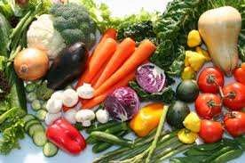


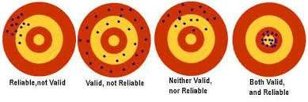
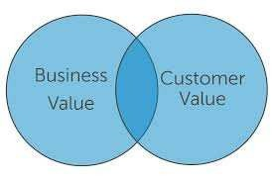
Data’s V-Dimensions
Volume
Variety
Veracity
Data Size & Growth Rate
Data types
Can the elicited results be believed?
Velocity
Validity
Value
Speed requirements
Legitimacy of the data sets (governance provisions)?
What business advantages can be gleaned?

Slide 8
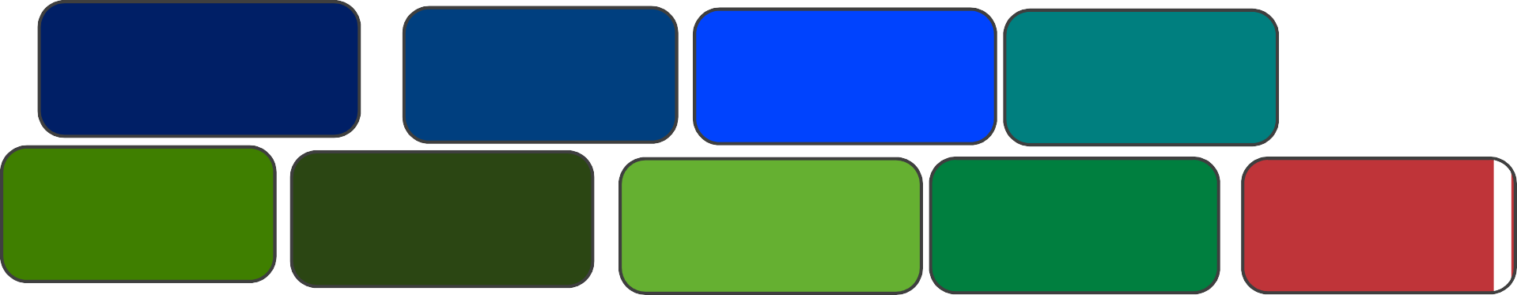
Part II:
Older Methods of Storing Big Data
File Systems
Network Database Model
Object Database Model
XML Database Model
Data Warehouse
Hierarchical Database Model
Relational Database Model
Object-Relational Database Model
Content Management Systems
Distributed Databases

Slide 9
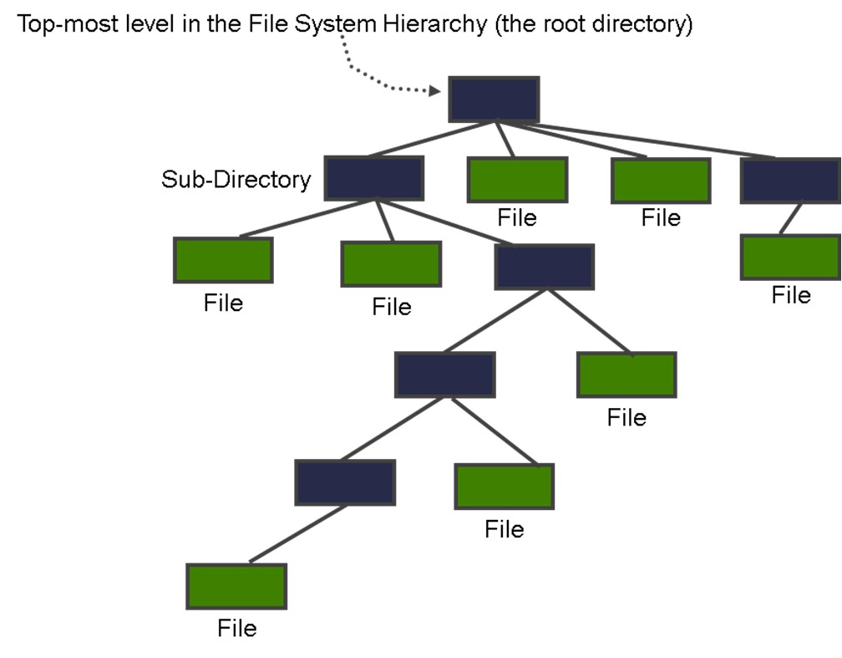
File Systems
File Systems
A collection of information that is arranged in a hierarchy.
  A file corresponds to a container for information.
  A directory corresponds to a container for files and directories.
  A sub-directory corresponds to a directory that is nested within another directory.
Operations
  Create, Read, Update, Delete, Find, Navigate
  operating system commands
  Applications
Examples
  Computer Operating Systems (DOS, Windows, Mac OS, Unix, VMS, etc.)
  Network File Systems (NFS), Network Attached Storage (NAS), File Servers, etc.

Slide 10
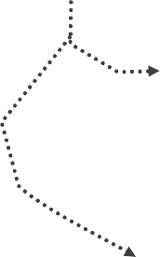
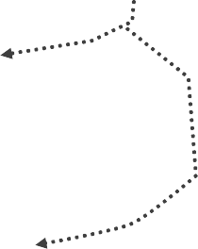
Hierarchical Database Model
Hierarchical Database Model
A hierarchical database consists of a collection of records which are connected to one another through links.
  A record corresponds to a collection of fields; each field contains a single data value.
  A link corresponds to an association between exactly two records.
Schema
Boxes represent record types
Lines correspond to links
Includes a data definition language (DDL) and a data manipulation language (DML)
Rooted Trees
Examples
  IBM’s Information Management System (IMS)
  Microsoft Windows Registry
Dummy Node for Records of type A
The records are organized into forests (collections of rooted trees).
Dummy nodes are used for each tree root.
A parent node can have multiple children (1:N).
A child node has exactly one parent (1:1).
No cycles are allowed in the structure.
Record Types
Links
A1
A2
Dummy Node for Records of type B
B1
B2
B3

Slide 11
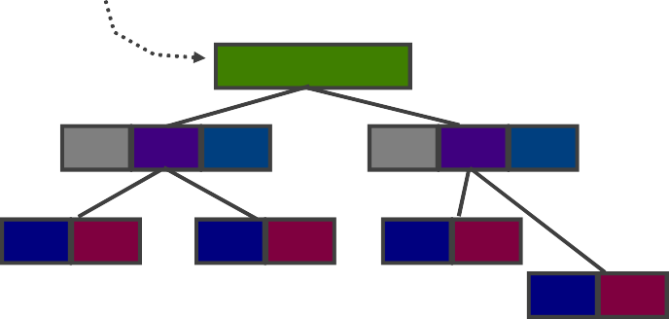
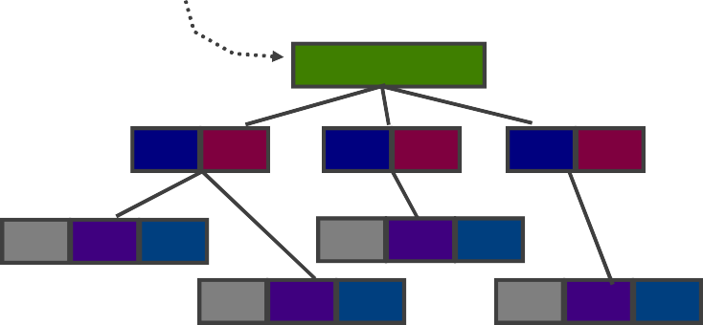
Hierarchical Database Model Continued
Hierarchical Database Model
Representing many to many (M:N) relationships between two record types A and B is accomplished through record duplication.
Create two different trees to depict the one to many relationships.
  A one to many relationship from A to B (tree T1)
  A one to many relationship from B to A (tree T2)
Record duplication is necessary to preserve the tree-structure organization of the database.
  Data inconsistency may result during updates
  Waste of space is unavoidable
Root of the tree T1
Root of the tree T2
A1
A2
B1
B2
B3
B1
B2
B3
A1
A1
B1
A2
A2

Slide 12
Hierarchical Database Model Continued
Hierarchical Database Model
Addressing Data Duplication with Virtual Records
  Contain no data, only represent a logical pointer to a physical record.
  When a record is to be replicated in several database trees, only a single copy of the record is kept in one of the trees. All other records are replaced with virtual records.
Dummy Node for Records of type A
A1
A2
Dummy Node for Records of type B
B1
B2
B3
Root of the tree T1
Root of the tree T2
Virtual-B1
Virtual-B2
Virtual-B3
Virtual-A1
Virtual-A2
Virtual-A1
Virtual-A2
Virtual-A1
Virtual-A2
Virtual-B1
Virtual-B2 Virtual-B3
Virtual-B1

Slide 13
Network Database Model
Network Database Model
A network database consists of a collection of records which are connected to one another through links.
  A record corresponds to a collection of fields, each field contains a single data value.
  A record and its fields are represented by a record type.
  A link corresponds to an association between exactly two records.
  Unlike in a hierarchical database, network databases allow cycles and can accommodate arbitrary information graphs.
Schema
Boxes represent record types
Lines correspond to links
Links can be one-to-one (1:1), one-to-many (1:N), many-to-one (N:1), and many-to-many (M:N).
Includes a data definition language (DDL) and a data manipulation language (DML)
Computer Associates Integrated Database Management System (CA IDMS)
Examples
Link
Graph which represents the relationship between A and B
A1 A2
Record Type A
Record Type B
B1
B2
B3

Slide 14
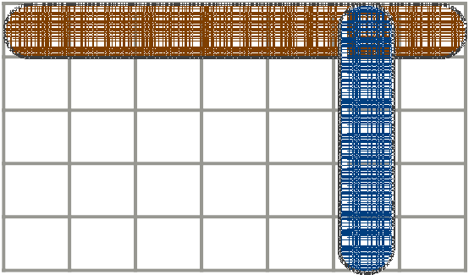
Relational Database Model
Relational Database Model
A relational database consists of a collection of tables (relationships).
  Rows in each table represent individual records.
  Columns in each table represent attributes (or fields).
  Each table is made up of key and non-key fields.
  Associations between tables (relationships) are realized through other tables
Table that represents all records of type T
Attr1 Attr2 Attr3
...
Attrm-1 Attrm
Record1
Record2
.
.
.
Recordn
Examples
  Apache Derby, IBM DB2, Informix, Ingres, Microsoft Access, PostgreSQL
  Microsoft SQL Server, MySQL, Oracle, Paradox, JavaDB
Table for A
Table for B
Table for Relationship between A and B

Slide 15
Relational Database Model Continued
Relational Database Model
Relational Database Theory
  Based on the concept of normal forms.
  The higher the normal form for a table, the less susceptible it is to inconsistencies and anomalies
ACID Properties
  Atomicity - All operations occur or none occur, no partial transactions
  Consistency - Transaction brings the database from one valid state to another valid state
  Isolation - No transaction should be able to interfere with another transaction
  Durability - Once a transaction has been committed, the changes are permanent
Normal Form | Description
3NF | 2NF and no non-key fields depend on any field(s) that are not the primary key.
EKNF | A subtle enhancement to 3NF for when there is more than one unique composite key and keys do not have one or more fields in common.
BCNF | (Boyce-Codd Normal Form) 3NF and every determinant (field used to determine another field in the table) could be a primary key.
4NF | A multi-valued dependency (MVD) is a functional dependency where the dependency may be to a set and not just to a single value. It is defined as X→→Y in relation R(X,Y,Z), if each X value is associated with a set of Y values in a way that does not depend on the Z values. BCNF and for every non-trivial multi-valued dependency (X→→Y) in F⁺ (closure of functional dependencies), X is a super-key of R.
5NF (PJNF) | (Project-Join Normal Form) A join dependency (JD) can be said to exist if the join of R1 and R2 over C is equal to relation R; where R1 and R2 are the decompositions R1(A,B,C) and R2(C,D) of a given relation R(A,B,C,D). 4NF and every join dependency is a consequence of its relation (candidate) keys. That is, for every non-trivial join dependency *(R1,R2,R3) each decomposed relation Rj is a super-key of the main relation R.
DKNF | (Domain-Key Normal Form) Requires that a table contain no constraints other than domain constraints and key constraints.
6NF | Requires that the database table contain no non-trivial join dependencies. That is, the table is in 5NF, is of degree n, and has no key of degree less than n - 1.
Normal Form | Description
1NF | All records have the same number of fields, no nested fields.
2NF | 1NF and all fields in the key are needed to determine the values of the non-key fields.

Slide 16

Relational Database Model Continued
Relational Database Model
Keys
  Simple
    Single attribute that uniquely identifies each tuple (row) in a table.
  Primary
Unique set of attributes that identifies each tuple (row) in a table.
Composite
  Two or more attributes that uniquely identify each row; where at least one attribute is NOT a simple key on its own.
Compound
  Two or more attributes that uniquely identify each row; where each attribute is a simple key on its own.
Candidate
  A minimal super key.
Super Key
  A set of attributes for a relation upon which all attributes are functionally dependent.
Foreign
  Unique set of attributes that identifies each tuple (row) in a different table.

Slide 17
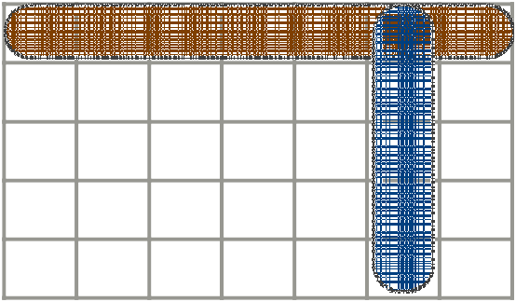
Relational Database Model Continued
Relational Database Model
Data Manipulation
  Select (Vertical/Horizontal Slicing), Update, Delete
  Join (Building Intermediate Tables)
    Cross, Theta, Equi, Natural, Inner, Full Outer, Left Outer, Right Outer
  Query Optimization
  Set Operations
    In, Not In, Union, Intersect, Except (Difference), Group By, Having,
  Nested Queries
  Views
Structured Query Language (SQL)
  A declarative (as opposed to imperative), standards based language (e.g. SQL-2011) for creating, querying, and manipulating relational databases.
  Data Definition
    Create, Alter, Drop
    Indexes, Constraints, Triggers, Stored Procedures
    Access controls
Selection
Join
➡
© 2013-2014 Cisco and/or its affiliates. All rights reserved.
Selection
Cisco Confidential
22

Slide 18






















Relational Database Model Continued
Relational Database Model
R1 | R2 | R3
1 | 2 | 3
2 | 3 | 4
S1 | S2 | S3
3 | 4 | 5
1 | 2 | 3
R1 | S1
1 | 3
3 | 1
R
S T Examples
Select *
From R cross join S;
Select * From R,S;
Select * From R,T
Where R.r3 < T.s1;
Select * From R join T
On R.r3 < T.s1;
R1 S1
Select *
From R Left Outer Join T On R.r1 = T.r1;
R1 R2 R3 R1 1 2 3 1
2 3 4 Null
Select *
From R Full Outer Join T On R.r1 = T.r1;
R1 R2 R3 S1 S2 S3
1 | 2 | 3 | 3 | 4 | 5
1 | 2 | 3 | 1 | 2 | 3
2 | 3 | 4 | 3 | 4 | 5
2 | 3 | 4 | 1 | 2 | 3
R1 R2 R3
1 2 3 1 3
S1
(Select *
From R Left Outer Join T On R.r1 = T.r1)
3
Equi Join (theta join using =)
Null
Select *
From R natural join T;
R1 R2 R3 S1 1 2 3
Left Outer Join (all rows from left)
Union
Cross Join (cross product)
Select *
From R Right Outer Join T On R.r1 = T.r1;
R1 R2 R3 R1 1 2 3 1
Null Null Null 3
(Select *
From R Right Outer Join T On R.r1 = T.r1);
R1 R2 R3 R1
1 2 3 1
2 3 4 Null Null Null Null 1
Select * From R,T
Where R.r1 < T.r1;
R1 R2 R3
1 2 3
2 3 4
Select * From R join T
On R.r1 < T.r1;
R1 S1
3 1
3 1
3
Natural Join (equi join on common attributes)
S1
S1
Select *
From S inner join T
on S.s3 > (T.r1 + T.s1);
S1 S2 S3
3
3
1
Null
R1
S1
Right Outer Join (all rows from right)
3

Slide 19
























Relational Database Model Continued
Relational Database Model
R1 | R2 | R3
1 | 2 | 3
2 | 3 | 4
S1 | S2 | S3
3 | 4 | 5
1 | 2 | 3
R1 | S1
1 | 3
3 | 1
U1 | U2 | U3
1 | 1 | 1
1 | 1 | 2
1 | 2 | 3
1 | 2 | 4
2 | 1 | 1
2 | 1 | 2
2 | 1 | 3
R
S T U
Examples Continued
(Select r1 From R) Union (Select r1 from T); Union (unique rows from two tables) | (Select r1 From R) Select u1 Except From U (Select r1 from T); Group By u1 Having count(u2) > 2 AND ^{R1} sum(u2) > 3 AND 2 sum(u3) > 5;
 | Difference (rows in first table but not in second) | U1 1 Group By (grouping) and Having (operations on aggregates)
 | Select * From R Where r1 In (2,4,6); R1 R2 R3 2 3 4 Set Inclusion
(Select r1 From R) Intersect (Select r1 from T); R1 1 Intersection (unique rows in both tables)
 | Select * From S Where s2 Not In (1,2,3); S1 S2 S3 3 4 5
R1
1
2
3
Select count(*)
From
(Select u1 From U Group By u1
Having count(u2) > 2 AND sum(u3) > 4) as Temp;
Count
© 2013-2014 Cisco and/or its affiliates. All rights reserved.
Set Exclusion
2
24
Nested Query

Slide 20
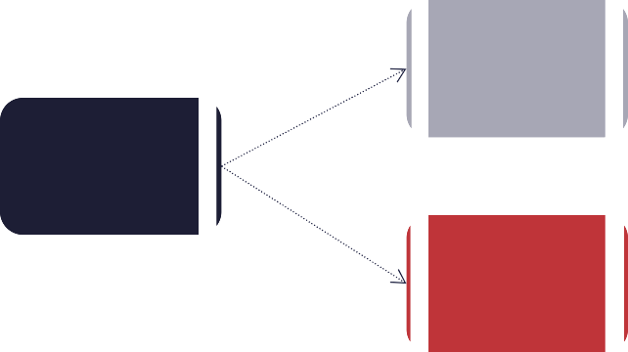
Relational Database Model Continued
Relational Database Model
View
  A saved query that represents a virtual table.
  Allows information hiding.
  The virtual table is populated at access time.
  Read-only access
    Select ... From view_name …
Materialized View
  A saved query that represents a persistent (as opposed to virtual) table.
  Like a view with respect to
    Information hiding
    Read-only Access
  Differences from a regular view
    Refreshed periodically (configurable).
    DDL syntax (e.g. create materialized view …)
    Not available with every RDBMS
Create view view_name As
SQL_Query;
Create OR Replace View view_name As
SQL_Query;
Drop View view_name;
Virtual Table
View
Actual Table
Materialized View
Saved Query
Definition

Slide 21
Object Database Model
Object Database Model
ODBMS also known as Object-Oriented Database Management Systems (OODBMS)
Examples
  db4o, Caché, eXtremeDB, Perst, Objectivity/DB, ObjectStore, Versant Object Database, ObjectDB, VOSS
Object-Oriented Concepts
  Class (Template, like a cookie cutter)
    Properties (attributes) / Behaviors (actions/methods)
    Access/Visibility to properties and behaviors
  Object (a cookie cut into the memory dough)
    An instance of a class
  Encapsulation
    Storing an object’s properties and behaviors together as part of the instance
  Relationships
    Inheritance (Single, Multiple) / Inheritance Hierarchy
ObjectID
Properties Behaviors
Object Class
getID, setID
IS-A
Person Class
SSN, Name, Birthdate
Properties Behaviors
getSSN, setSSN, getName, setName,
getBirthdate, setBirthdate, getAge
IS-A
Properties Behaviors
Org, Dept, Title, Mgr, EmployeeID, HireDate
Employee Class
getOrg, setOrg, getDept, setDept, getTitle, setTitle, getEmployeeID, setEmployeeID, getMgr, setMgr, getReportingHierarchy, getDirectReports, getCoworkers, getHireDate, setHireDate
OODBMS are integrated with an object-oriented programming language similar to RDBMS but with
an object-oriented database model. Objects, classes, and inheritance are directly supported in the database schemas and in the query language.

Slide 22
Object Database Model Continued
Object Database Model
Object-Oriented Programming Languages
  C++, Java, C#, JavaScript, Ruby, Smalltalk, Scala, Groovy, ParaSail, Ceylon, Clojure, JRuby, ...
Object-Oriented Applications
  Dynamically create and destroy objects
  Leverage an Object Graph during the application’s execution
Object-Oriented Database Management Systems
  Support the modeling and creation of data as objects
  Include support for classes of objects and the inheritance of class properties and behaviors (methods) by subclasses and their objects.
  Create, Read (Search), Update, and Delete objects in the Database <CRUD Operations>
  The class structure is the database schema
  Persistence - Explicit and Transparent
    Explicit Persistence - CRUD operations are performed in the code
    Transparent Persistence - Objects are moved to and from the database invisibly
Transactions
Queries
Indexes
Administration, including tuning
Instantiated Objects @ Time t

Slide 23
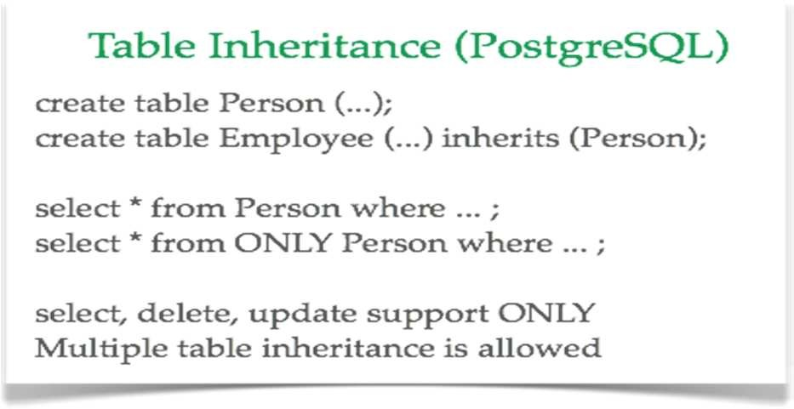
Object-Relational Database Model
Object Relational Database Model
Try to bridge the gap between traditional RDBMS and OODBMS
  Includes the full suite of RDBMS features
  Object-oriented features typically vary by vendor and revolve around the SQL-99 specification
  Inheritance (Table & Type)
  User-defined Data Types (Attributes & Tables)
  Functions for user-defined data types (UDTs)
Examples
  PostgreSQL, CUBRID, Oracle, Informix, DB2, SQL Server

Slide 24
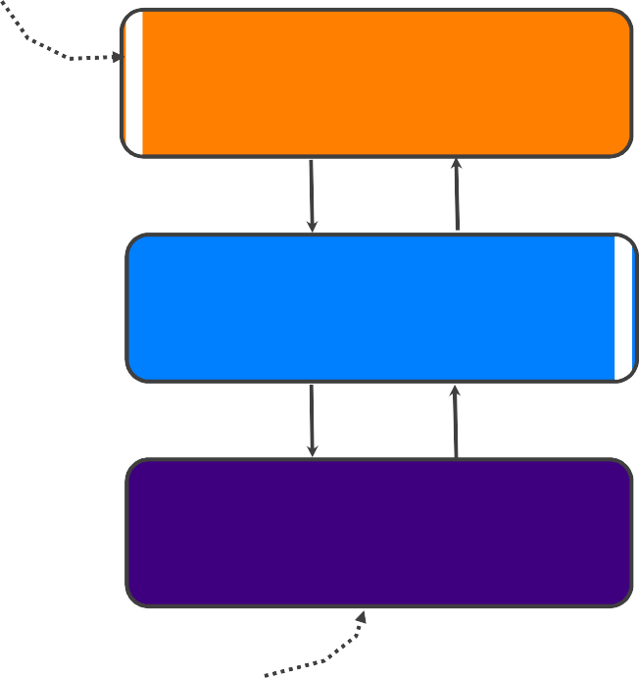
Object-Relational Database Model Continued
Object Relational Database Model
A popular alternative to an ORDBMS is using an Object Relational Mapping (ORM) framework with a RDBMS
  Apache Cayenne, Hibernate, JDO, JPA, GORM, Active Record, ...
ORM frameworks allow
  Software engineers to focus on and work with objects
  Database designers to focus on and work with relational database constructs
  The impedance mismatch between objects and tables to be transparently handled
Objects
Object-Oriented Application
Maps objects to tables and vice versa
ORM Framework
RDBMS
Tables

Slide 25
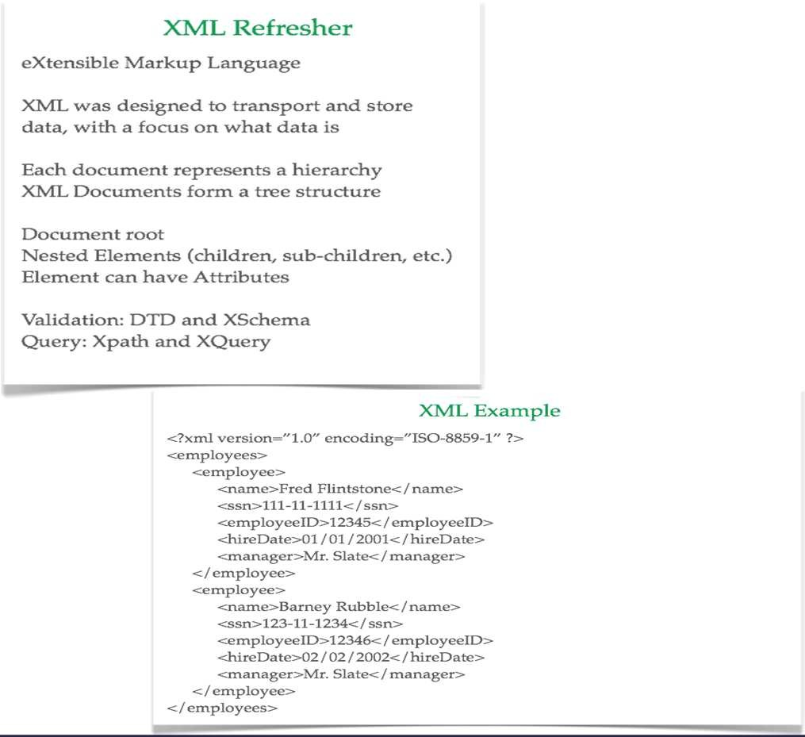
XML Database Model
XML Database Model
Two approaches: XML-enabled and Native XML databases
  XML-enabled databases
    rely on a middle-tier to transform XML to another DB representation
  Native XML Databases
    store, manipulate, and query XML documents
Examples
  Sedna, Xindice, BaseX, eXist, MarkLogic Server, MonetDB/XQuery

Slide 26




Content Management Systems
Content Management Systems
Enterprise Content Management Systems (ECMs)
  Provide a mechanism to organize documents in various formats (structured and unstructured data)
  Administrative and User Tools
  Access control based on roles and permissions
  Storage and retrieval of data/Version Control
  Workflows
Examples
  OpenCMS, Alfresco, WordPress, Apache Lenya, Apache Jackrabbit, SharePoint, Interwoven, Documentum,
APIs
Proprietary
JSR-170 (Content Repository API for Java)
Content Management Interoperability Services (CMIS)
  Open standard for controlling diverse document management systems & repositories
User
User + Admin Tools
Application
API
Content
Content Management System

Slide 27
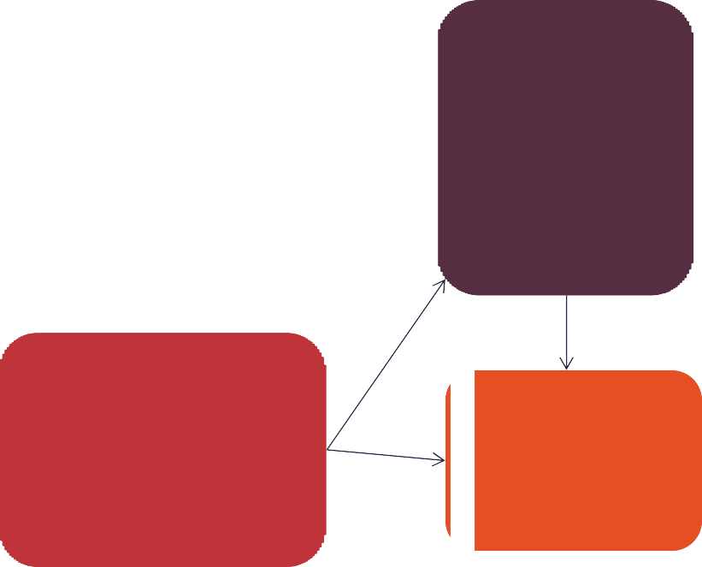
Enterprise Data Warehouse
Data Warehouse
Data Sources
Data Warehouse
A giant data repository facilitating various types of data aggregation, reporting, business intelligence (BI), data mining, and analytics processing.
  Data from the various source systems is placed into the warehouse via extract, translate, and load processes (ETL).
  Data marts represent specialized data warehouses.
  Tools are leveraged to extract new insights from the data warehouse and data marts.
Sales
Marketing
Supply Chain
Operations
ETL
ETL
ETL
Data Vault
ETL
…
ETL
Exploration, Mining, and Reporting Tools
Data Mart(s)

Slide 28
Distributed Databases
Distributed Databases
Database system in which the data - and sometimes processing – is not centralized
  Database Duplication
    Active/Passive Configuration
  Database Replication
    Active/Active Configuration
    Conflict detection and resolution
  Database Fragmentation (DRDBMS)
▪
Data distributed/partitioned across locations
▪
Vertical (columns) and horizontal (rows) slicing
▪
Semi-Joins
▪
Expensive to ship data across the network
▪
Local query optimization based on costs/combine results

Slide 29
Part III:
New methods for Storing Big Data

Slide 30
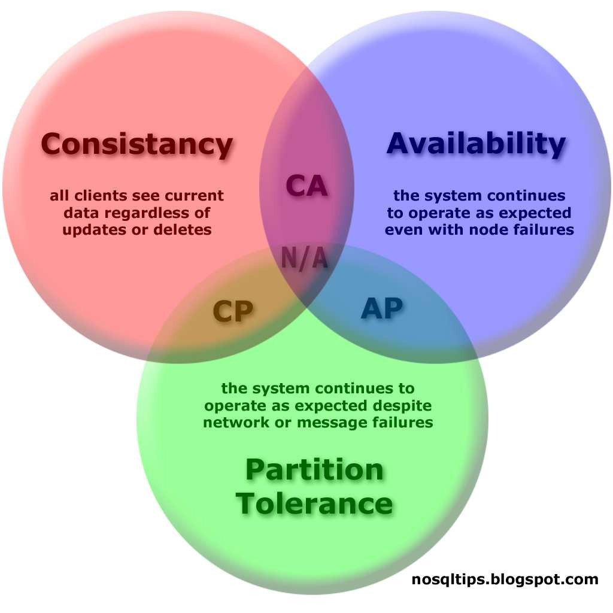
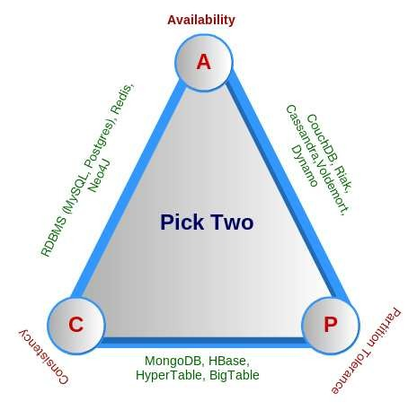
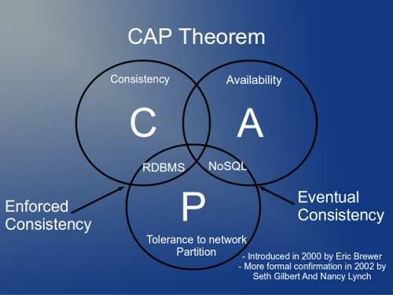
Not Only SQL/No SQL (NOSQL) Approaches
NOSQL databases represent newer data models aimed at Big Data problems.
Differ from the relational model in several ways:
  SQL is not used as the primary query language
  Fixed-table schemas may not be required
  Joins are generally not supported
  ACID (atomicity, consistency, isolation, durability) guarantees may not exist
  Architectures typically leverage massively distributed computing resources (processing and storage)
CAP Theorem (Brewer’s Theorem)
  Impossible for a distributed computer system to simultaneously provide three of the following guarantees:
  Consistency - All nodes see the same data at the same time
  Availability - Every request receives a response about whether or not it was successful
  Partition Tolerance - The system continues to operate despite arbitrary message loss or failure of part of the system

Slide 31
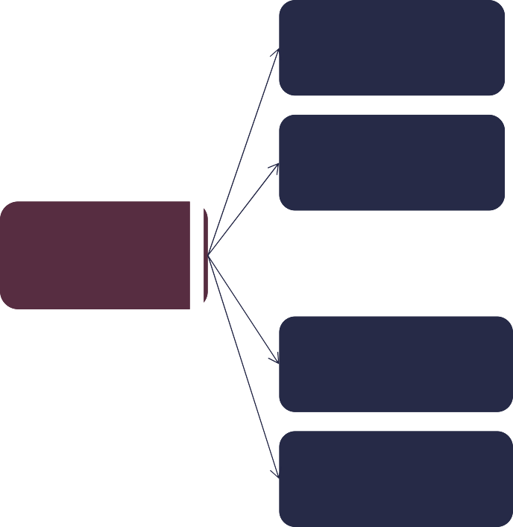
Not Only SQL (NOSQL) Approaches Continued
NOSQL Database Types
  Categorized according to the way they store their data
    Key-Value Stores
    Document Stores
    Column Stores
    Graph Databases
Shard 1
Shard 2
Large Database
Partitioning scheme (e.g. hash function)
…
Application
Sharding
  Horizontal Partitioning
  Breaking a large database into several smaller databases that share nothing
    The smaller databases can be distributed across multiple servers.
  Size of database and # of transactions increases linearly, while query response time increases exponentially
Shard N-1
Shard N

Slide 32
Key-Value Stores
Two-column table (key, value)
  Keys are unique
  Values do not have to be unique
Basic operations:
  AddOrUpdate(key, value)
  GetValue(key)
  DeleteKey(key)
  DoesKeyExist(key)
Feature Differentiation
  Complexity of the keys
  Advanced operations (e.g. Expire, Lists, Sets, Hashes, …)
  Distributed vs. Non-distributed
  Memory-resident vs. Disk-based
Examples
  Redis, Voldemort, Riak, Hibari, MemcacheDB, BerkeleyDB, Amazon S3, …
Key | Value
key_{i} | value_{i}
key_{j} | value_{j}
… | …
key_{n-1} | value_{n-1}
key_{n} | value_{n}

Slide 33
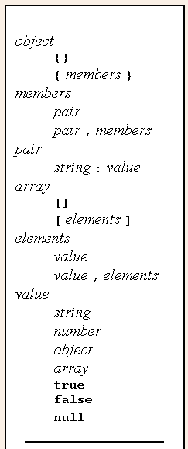
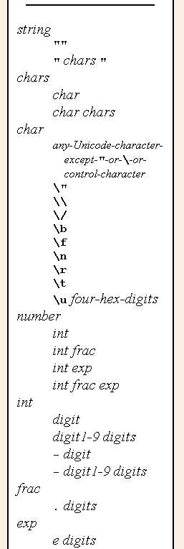
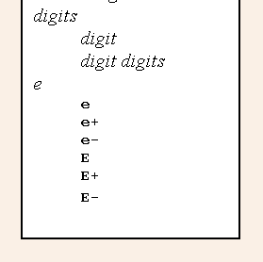
Document Stores
JSON Syntax
A database of JavaScript Object Notation (JSON) or Binary JSON (BSON) “documents”
  JSON is a light-weight data interchange format
  Based on a subset of the Object-Oriented JavaScript programming language
Documents are analogous to records with fields and values.
  Grouped into collections.
{
Collections are indexed.
Examples
  CouchDB, MongoDB, RavenDB, …
“name” : “Michael”, “GolfHandicapIndex” : 5, “Scores” : [
{“course” : “Lakeridge”,
“score” : 73},
From json.org
Programming Language Tools & Frameworks
  See http://json.org
{“course” : “Wolf Run”,
“score” : 77},
{”course” : “Wildcreek”, “score” : 79}
}
]
JSON Example

Slide 34
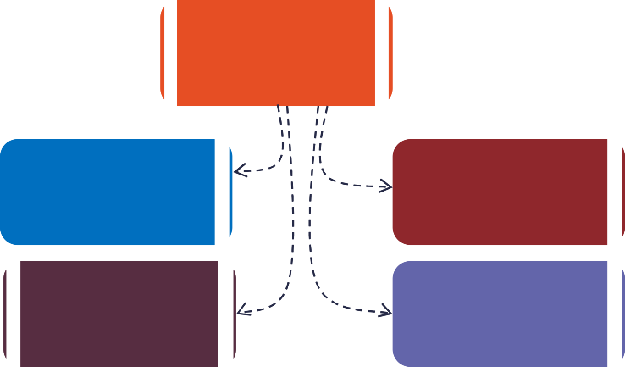
Column Stores
Bigtable Col_{B} Col_{C} …
Col_{A}
Col_{M}
Row₁ Row₂
timestamp
Motivated by Google’s “Bigtable: A Distributed Storage System for Structured Data” [2006]
  For random read/write access to big data – consisting of billions of rows and millions of columns – atop clusters of commodity hardware.
  Vertical partitioning of the data according to the attributes (columns).
  “A Bigtable is a sparse, distributed, persistent, multi- dimensional sorted map [row key, col key, timestamp]
…
M,N are large
Row_{N}
Main Ideas
  Large tables can be expensive to process (entire row must be read).
  Extensible records that are partitioned across nodes.
  Rows and columns comprise the data model.
  Horizontal sharding based on row keys (key ranges)
  Columns can be partitioned into column groups/column families (allow related columns to be kept together)
Bigtable
Apache HBase
Apache Accumulo
Apache Cassandra
DynamoDB, Hyberbase, …

Slide 35
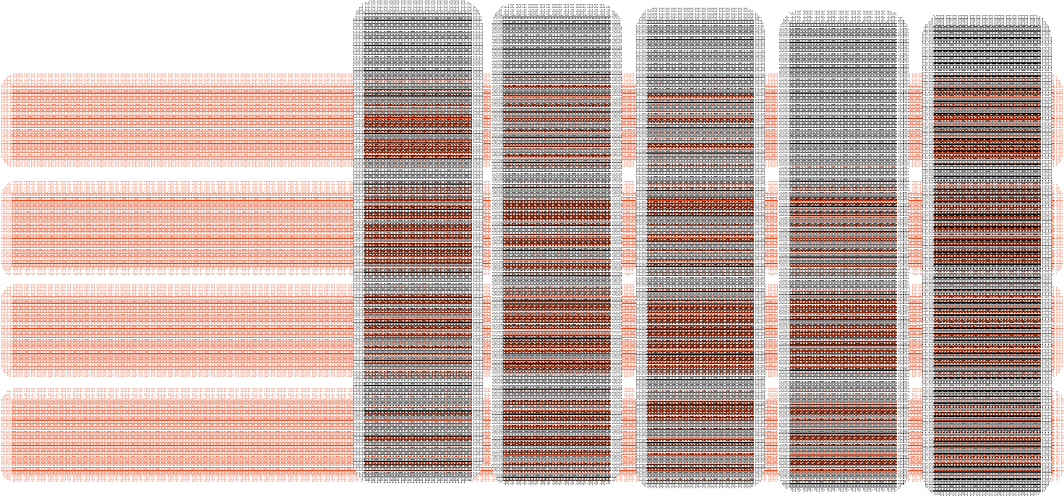
Column Stores Continued
Assume the columns are aggregated into 5 different column groups/families
{
Col_{A}
Col_{B} Col_{C} …
Col_{M}
timestamp
{
Row₁ Row₂
Assume the row keys are partitioned into 4 different ranges
M,N are large
…
Row_{N}
CF
1111
CF₂
CF₃
CF₄
CF₅
timestamp
Row key range 1
Row key range 2
Row key range 3
Row key range 4
Database distributed over 4 x 5 = 20 nodes

Slide 36
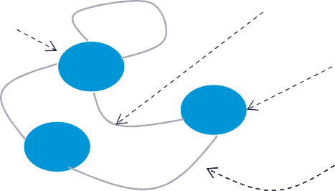
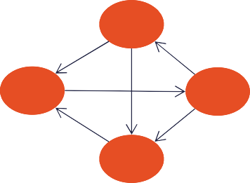
Graph Databases
Basics
Undirected Edge
Property₁: Value₁
Leverage graph structures with nodes, edges, and properties to represent and store data.
Nodes in a graph are similar to objects in that they have attributes/properties
Edges are used to represent a relationship between two nodes or between a node and a property
Properties represent attributes that are associated with nodes or edges (relationships)
Hyper-edges represent a relationship between a set of nodes.
A traversal navigates a graph, equivalent to performing a query
Fully-transactional, enterprise-strength databases
Node
{
{
A
Property₂: Value₂
…
Property_{N}: Value_{N}
C
B
Property_{A}: Value₁ Property_{B}: Value₂
…
Property : Value
Undirected Graph
Z Z
E
Directed Edge
Node
D
F
Application developers leverage an object- oriented, flexible network structure instead of static tables
G
Directed Graph
41

Slide 37
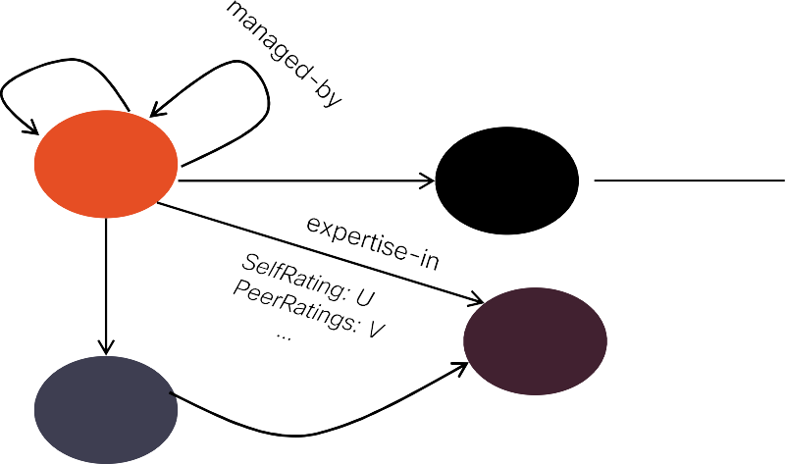
Graph Databases Continued
Key Points
  Nodes (vertices) represent entities.
  Edges represent relationships.
  Nodes and edges are able to have properties
    Property Graphs
  Query = Traversal
  Network Science
  Graphs are everywhere!
Examples
  Neo4j, InfiniteGraph, OrientDB, AllegroGraph, Titan, …
follows
Person
Name: X ID: Y
……
P
interested-in
I_{A}
Areas of Interest Interest Area: I
……
YearsInRole: Y Ratings: R
…
has-role
E_{A}
J
Job Roles Job Role: J
…
requires
Areas of Expertise Expertise Area: E
…
RequiredProficiencyRating: W
…
Queries/Traversals/Algorithms for identifying:
Who are the best mentors for a person P? Who are the experts in expertise area E? What areas does person P need to improve in? What are the intellectual capital risk areas?
How do the people in job role J compare /who is promotion ready?
.
.
.
42

Slide 38
New SQL Approaches
Motivation
  High-volume transaction-oriented systems (e.g. financial, order processing, etc.) cannot give up strong transactional and consistency requirements, and therefore are left wanting with respect to NOSQL options.
Enter New SQL
  A class of RDBMS that aim to provide the same scalability as NOSQL systems for on-line transaction processing (OLTP) – significant read/write activity – whilst still maintaining ACID properties and utilizing SQL as the primary interface.
Approaches
  Parallel Databases (parallelization of various operations)
    Multi-processor Architectures
      Shared Memory – multiple processors share the main memory space
      Shared Disk – nodes have autonomous memory, but share mass storage
      Shared Nothing – nodes have their own main memory and mass storage
Hybrid Architectures
  Non-Uniform Memory Access (NUMA)
    Memory access relative to the processor (local vs. other vs. shared)
  Cluster
    Distributed cluster of shared-nothing nodes where each node owns a subset of the data. Transactions and queries are fragmented and routed to the nodes that contain the needed data.
In-Memory Databases
  Memory is always faster than mass-storage
  For high-volume transactions that are short-lived, access a small subset of the available data, and are executed over and over with different inputs.
NewSQL Examples
  Google Spanner, Clustrix, FoundationDB, NuoDB, Translattice, VoltDB, Pivotal’s GemFire & SQLFire, MemSQL
43

Slide 39
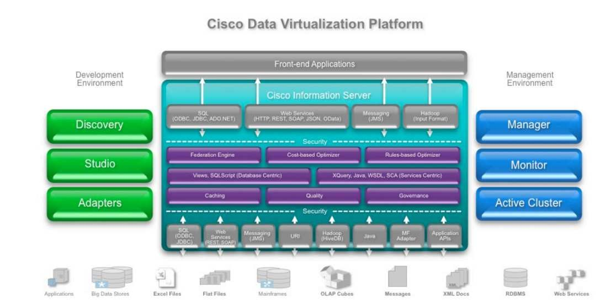
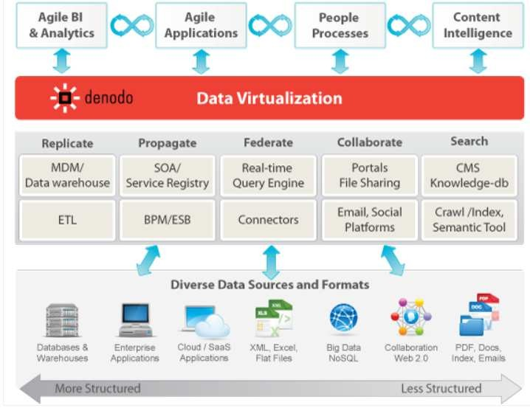
Data Virtualization
www.cisco.com/web/services/enterprise-it-services/data-virtualization/documents/cisco-information-server-62-ds.pdf
An approach to data management that allows an application to retrieve and manipulate data without
requiring details about the underlying data model or where the data is located.
  Differs from ETL in that the source data remains in place.
  Data in the source systems is readable and can also be writable.
Features
  Abstraction (location, data model, API, access language, …)
  Virtualized Data Access (common access point)
  Transformation (transform/reformat for use)
  Data Federation (combine data sets from multiple sources)
  Data Delivery (publish views and/or services for reuse)
Examples
  Denodo, Composite (Cisco), Informatica, IBM SmartCloud Data Virtualization, …
Cisco Confid
http://www.denodo.com/en/product/features.php
44

Slide 40
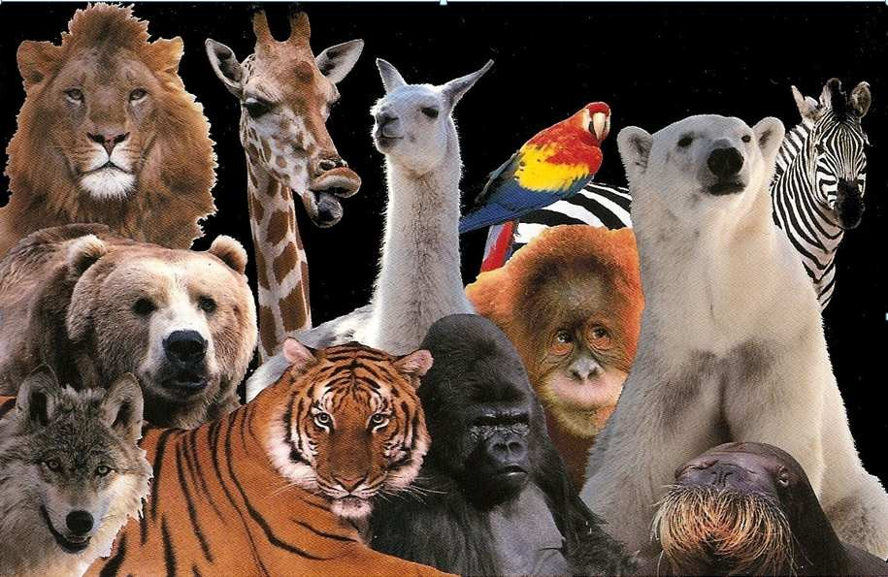
Part IV:
Tools for Processing and Accessing
Big Data
The Big Data Tool Zoo
46

Slide 41
The Big Data Tool Zoo (Part 1): Apache Hadoop
Other Tools
+ Processing large data sets.
Framework which enables distributed processing of large data sets across clusters of computers.
Primary Components
  Hadoop Common
  Hadoop Distributed File System (HDFS)
    Build an HDFS instance
    Use FS commands for interactive access
      hadoop fs –ls
      hadoop fs –mkdir –p /user/hadoop/demo
      hadoop fs –copyFromLocal myBigData /user/hadoop/demo
      hadoop fs –cat /user/hadoop/demo/myBigData
      Many other commands
  Hadoop YARN
    Facilitates interaction patterns for data in HDFS
      Batch (MapReduce), Interactive (Tez), Online (HBase)
      Streaming (Storm), Graph (Giraph), In-memory (Spark), others
  Hadoop MapReduce
    Batch-oriented processing: Map, Shuffle, Reduce
©\
Hadoop MapReduce
+ Batch-oriented, parallel processing of large data sets
Hadoop YARN
+ Framework for job scheduling and cluster resource management.
+ Facilitates broad array of data interaction patterns.
Hadoop Distributed File System (HDFS)
+ Redundant, reliable storage.
+ Designed to run on commodity hardware.
+ Highly fault tolerant (failures expected)
+ Fast fault detection and automatic recovery.
+ Suitable for large data sets distributed across multiple nodes.
+ Provides high aggregate data bandwidth.
+ Designed for batch processing and providing streaming access.
+ Scales to hundreds of nodes in a single cluster.
+ Supports tens of millions of files in a single instance.
+ Interactive access provided via File System (FS) commands.
Hadoop Common
+ Common utilities and libraries to support the other modules.
Apache Hadoop Ecosystem
47

Slide 42
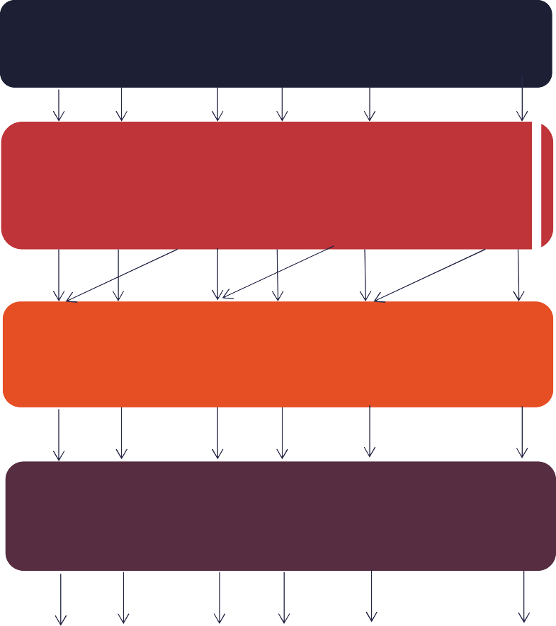
MapReduce
Input Data
+ Processed in parallel in order to elicit a set of (key, value) pairs
Map Phase
+ Map(inKey, inValue) € List (outKey, intermediateValue)
+ System applies the map function in parallel to all input key/value pairs in the input file.
MapReduce
  Google paper [2004]
  High-level programming model and implementation for large-scale parallel data processing
  Free variant: Hadoop
  Google claims in 2014 that its Cloud Dataflow is meant to replace MapReduce.
MapReduce Programming Model
  Input and Output: each a set of (key, value) pairs
  Programmer specifies two functions:
    Map (inKey, inValue) € List (outKey, intermediateValue)
      Processes input key/value pair
      Produces (emits) a list of intermediate key/value pairs
    Reduce (outKey, List (intermediateValue)) € List (outValue)
      Combines all intermediate values for a particular key
      Produces a set of merged output values (usually just one)
Shuffle Phase
+ All pairs with the same intermediate key are grouped together – similar to what an SQL “group by” would do
Reduce Phase
+ System applies the reduce function in parallel to all intermediate
values for a particular key and produces a set of merged output values as a result
MapReduce FundamentalsCisco Confidential
48

Slide 43
MapReduce Examples
Word Frequency from a Corpus of Documents
How many times does each unique word occur?
Reduce
(doc_id, value)
(id1,v1)
(id2,v2)
(id3,v3)
…
(word, count)
(w1,1)
(w2,1)
(w3,1)
(w1,1)
(w2,1)
…
(word, list of values)
(w1,(1,1,…))
(w2,(1,1,…))
(w3,(1,…))
…
(word, frequency)
(w1, 15)
(w2, 27)
(w3, 22)
…
Map
Shuffle
Word Length Histograms from a Corpus of Documents
(doc_id, value)
(id1,v1)
(id2,v2)
(size, count)
(small,7)
(medium,15)
(big,3)
(small,10)
(medium,8)
(big,4)
(size, list of values)
(small,(7,10))
(medium,(15,8))
(big,(3,4))
(size, frequency)
(small, 17)
(medium, 23)
(big, 7)
How many big, medium, and small words occur, where big € 12+ letters, medium € 5…9 letters, and small € 1..4 letters?
Reduce
Map
Shuffle
49

Slide 44
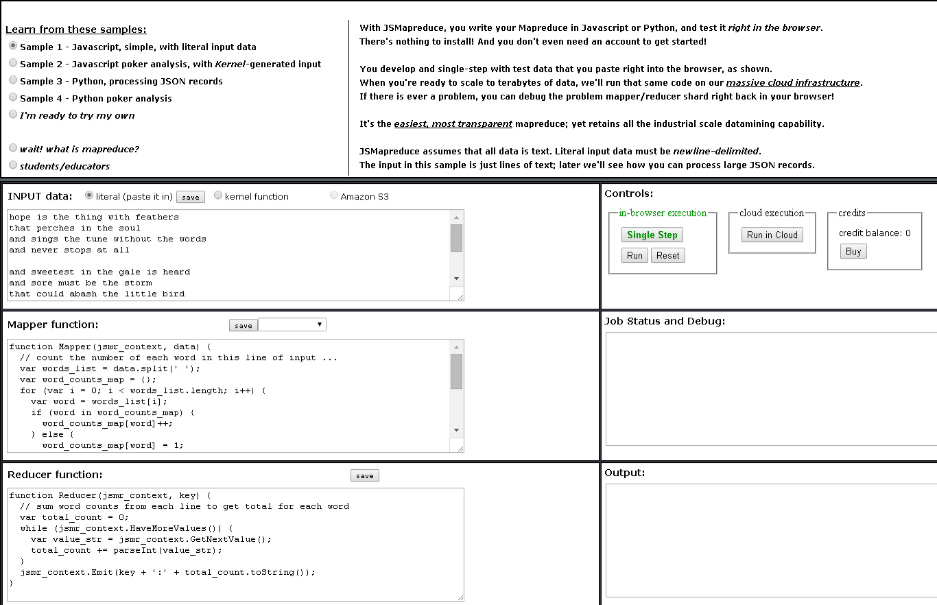
MapReduce Try for Yourself with jsmapreduce
Go to www.jsmapreduce.com
Register for a free account
Try the examples (JavaScript and/or Python)
Extend the examples or experiment with your own data
Input data
Execution Controls
Cisco
Map Function
Status
Reduce Function
Output

Slide 45
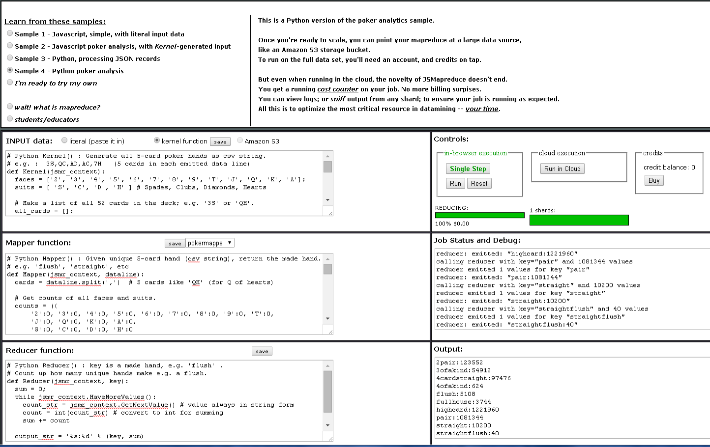
JSMapreduce Example – Add 4-card straight to Poker

Slide 46






The Big Data Tool Zoo (Part 2): A broader perspective
Distributed application development framework; facilitates generic cluster resource management.
Application execution framework for complex directed-acyclic-graph (DAG) data processing tasks; accelerates Hadoop query processing.
Bulk Synchronous Parallel(BSP) Computing; advanced analytics beyond MapReduce; network algorithms, graph algorithms, machine learning, ….
Data warehouse software allowing the querying and managing of large datasets which reside in distributed storage using an SQL-esque language called HiveQL. Also allows custom mappers & reducers. Includes HCatalog table storage/mgmt.
Workflow scheduler (MR, Pig, Hive, …)
Analysis of large data sets; parallelization of MR tasks; Pig Latin language
Iterative graph processing which extends Google’s Pregel.
Real-time distributed processing of incoming data streams; real-time analytics, machine learning, …
Provision, manage, and monitor Hadoop clusters
Bulk data xfer between Hadoop and structured data stores.
Bigtable-esque (column store)
SQL-supported big data warehouse system for Hadoop
In-memory analytics, 100X faster than MapReduce; general purpose data processing for large datasets. Combines SQL (SparkSQL), streaming, and complex analytics.
Distributed stream processing, leverages Kafka messaging f/w
Distributed query engine; extends Google’s Dremel.
Cassandra
Mahout
Machine Learning
Fault-tolerant Bigtable-esque distributed database
Distributed Configuration Mgmt.
Streaming Event Data
Pig Hive
Drill
Samza
Tajo
Sqoop Ambari Twill
Hama Oozie Giraph Storm HBase Flume
Chukwa
Monitoring
Hive
Pig
Spark
MapReduce
Tez
ZooKeeper
MapReduce
(batch exec. f/w)
Hadoop YARN (Job Scheduling & Cluster Resource Management)
Hadoop Distributed File System (HDFS): Redundant, Reliable, Storage
Hadoop Common (Utilities and Libraries)

